Slide 1
Team resiliency How to motivate employees and manage burnout

Slide 2
Be active on Zoom
Camera on
VPN off if you are at home
Participate & share your thoughts

Slide 3
Agenda
Part 1 Opening
Resilience
Our COVID-19 experience
Coffee break
Part 2
Motivate your team
Well-being & Burnout - tips and tools

Slide 4
Objectives
Providing tools to motivate employees and manage burnout
Creating a space to process and reframe the recent period
Implementing well-being D2D behaviors in the team

Slide 5
Detailed Agenda
Don’t show - for facilitators only
Content | Activity | Time | Topic
Menti questions: In one word - describe your quarantine experience What did you do during a WFH meeting that you would NEVER do at work? What do you miss at the office and why? Write one good thing you will remember from the quarantine When you felt burnout, what did you do to motivate yourself? What did you do to motivate your team? | Opening - Menti | 15
 | Explaining the journey + Resilience | 5
2 rounds of breakout rooms: My Experiences (breakout rooms of 5 - 10 min Share picture in plenary - 10 min My Managerial Role (breakout rooms of 5 - 10 min Share “New behaviors moving into the new normal” - 10 min | My Experiences during COVID-19 | 40 | Reframe
Explain in plenary that the activity we did is reframing | Summary - reframe | 5
 | Break (10 min)
Share tips from Menti When you felt burnout, what did you do to motivate yourself? What did you do to motivate your team? | Motivate your team | 20 | Motivate
 | Well-being & Burnout - tips and tools | 20 min | Wellbeing
Think of one new habit you want to adopt | Self work and meditation | 5 min
Breakout rooms of 3: share tips on how to create well-being in my team - conclude on the whiteboard | Implementing well-being D2D behaviors in the team | 15 min
 | Summary | 10 min

Slide 6
Our C VID19 experience
Go to Menti.com | 55 20 78

Slide 7
What is resilience?
“
Resilience is merely the skill and the capacity to be robust under conditions of enormous stress and change
“
Show stability and trustworthiness.
Create a safe environment while staying true to your moral compass.
Contain the situation without exerting pressure
Notes:
What exactly is that quality of resilience that carries people through life?

Slide 8
How to Build Resilience?
Disruption
Stress
Reframe
Resilience
Well-being
Motivate
Notes:
This is the organizing model, explain a bit about each part: reframe, motivate, well-being

Slide 9
Zoom out
When building resilience, bouncing back will be faster, easier, and less painful
bounce back
bounce back
bounce back

Slide 10
The COVID-19 case
Re-entry
Quarantine
Closing offices
Burnout
My Journey
Working remotely
Becoming Effective
Disruption
Resilience
Stress
Recovery
bounce back

Slide 11
My Experiences during COVID-19
Closing offices
Working remotely
Becoming Effective
Quarantine
Burnout
Re-entry
My Experiences
What did you:
Think & Feel? Hear & See? Say & Do?
What did you fear the most?
What were your frustrations?
What were your obstacles?
What made you feel better?
What made you be more productive?
Share in plenary one group picture that captures your COVID-19 experience
Notes:
Share in groups of 5 via breakout rooms. After they have discussed their experience, they need to leave 2 minutes to pick a picture that best describes their experience.
Make sure they understand the focus is to talk about their own personal experience

Slide 12
Our Experiences during C VID-19

Slide 13
My Managerial Role during COVID-19
Closing offices
Working remotely
Becoming Effective
Quarantine
Burnout
Re-entry
My Managerial Role
What did you start doing differently?
How did you meet your team’s needs?
What new routines did you adopt?
After the group discussion, each to share behaviors moving into the new normal that they discovered during COVID-19 and which they would like to keep
Notes:
A uniqueness to the role of the manager is the fact that you wear multiple hats, which means you were the one that had the heaviest workload.
Share again in groups of 5 via breakout rooms. They need to collect 5 new behaviors moving into the new normal that they discovered during COVID-19 and that they would like to keep - they will share via whiteboard.

Slide 14
New behaviors moving into the new normal
That you discovered during COVID-19 and would like to keep
01
02
03
04
05

Slide 15
How to Build Resilience?
Reframe
Well-being
Motivate
Notes:
Explain in plenary that the activity we did is reframing, we did it so they will feel how important it is, when we work so hard it’s important to pause and think about it. Reframing is taking an experience that is difficult and seeing what we learned from it.

Slide 16
How to Build Resilience?
Reframe
Well-being
Motivate
Notes:
One of the things we heard from managers during the past period is that they are having a hard time keeping their employees motivated. How can we tell if our employees don’t have the drive and passion to do their work?

Slide 17
What demotivated behavior d I see on my team?
Notes:
Let 3-4 share in plenary

Slide 18
How do you recognize demotivation?
1
2
3
4
Lack of punctuality
arriving late to work, or an increased time to start work after arriving at the office
Increased absence from work
Increasing reluctance
to take on more responsibility than the 'bare minimum'
Lack of focus
5
6
7
Change in mood towards colleagues
Inappropriate or negative comments
Lack of input into team meetings
8
9
10
11
They will be demotivating other employees
Loss of Productivity
No visible sign of fun
Not wanting to improve
Notes:
Talk about 2-3 behaviors you want to emphasize. The most important thing is when they feel there is a change in their employee’s behavior, they should talk to him/her and make sure they are being noticed and getting the support they need.

Slide 19
MENTI
Notes:
Show their answer to those two questions from the first menti:
When you felt things were too much, how did you motivate yourself?
What did you do to motivate your team?

Slide 20
How to improve team motivation?
Team level
Individual level
Connect on a regular basis
Personalize –
talk to your employee to find his/her unique motivation
Make it fun!
Recognition
Make sure you create new routines
Notes:
There are ways to increase motivation at a team level (go over the list if they didn’t mention it in the menti), but it’s also really important to make sure you support them in a personalized manner with their unique motivation.

Slide 21
The puzzle of motivation
Dan Pink
Notes:
Career analyst Dan Pink examines the puzzle of motivation, starting with a fact that social scientists know but most managers don't: Traditional rewards aren't always as effective as we think. In 21st century tasks, extrinsic motivators, carrot and stick approach, often don't work, and often do harm.
Recommend to participants to watch this TED talk after the workshop:
https://www.ted.com/talks/dan_pink_the_puzzle_of_motivation

Slide 22
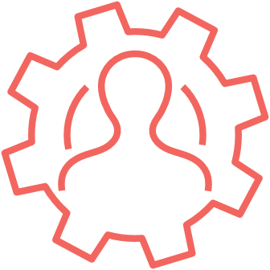
Motivation Model
Mastery
A sense of progress, not just in work, but also in our abilities, contributes to our intrinsic motivation. The desire to learn and develop
Autonomy
The desire to direct and control our actions ourselves
Sense of Belonging
A deep sense of engagement the employee feels towards his workplace and which causes him to invest a greater conscious effort in doing his job. The desire to work and be with people
Purpose
The desire for my work to be meaningful/purposeful
Notes:
Explain 4 types of motivations, ask participants to use the annotate-> stamp option in Zoom to mark their main motivation.

Slide 23
Motivation Model - typical characteristics
Mastery
Characteristics typical of an employee for whom this is the main type of motivation
The employee initiates learning of new fields of knowledge
The employee is perceived as an expert and professional in his field
It is important for the employee to excel in his field
Autonomy
Characteristics typical of an employee for whom this is the main type of motivation
If I am absent from work for a few days, the employee is able to function independently
In his everyday work, the employee does not approach me frequently with professional questions
If the employee encounters a new problem, he will likely try to solve it himself before approaching me for help
Sense of Belonging
Characteristics typical of an employee for whom this is the main type of motivation
The employee is socially engaged with the rest of the employees on the team
The employee prefers projects or tasks that are shared with other team members over tasks assigned to him only
The employee has one or more additional roles in the team besides his current role (for example: mentor, SME, other lateral role)
Purpose
Characteristics typical of an employee for whom this is the main type of motivation
The employee is strongly connected to the company values and works to uphold these values
The employee feels his work is highly meaningful
It is very important for the employee to be familiar with the goals and “missions” of his department
Notes:
Don’t talk about this slide too much, just let participants know they will have it as a tool after

Slide 24
How to Build Resilience?
Reframe
Well-being
Motivate

Slide 25
Let’s talk about YOU!
Notes:
When we reflect on the past months and digest what we have been through, some of the personal aspects people shared earlier refer to our need to invest in giving to others, in being there for your employees, for your family – partners, kids, parents and colleagues and community:
Long days, when sometimes we’re not even sure which day of the week it is
No real boundaries between work and life – there is no work life balance but more of a blend
Some of us needed to juggle between taking care of small children, housework and work and
some of us had to deal with loneliness or other extreme challenges
Seeing employees experiencing real difficulties and not always being able to help
Orchestrating a global, diverse symphony with different challenges, regulations and cultures
Prioritizing correctly in real time and more…
In many cases we sort of got used to this new routine, but many of us feel burned out…
When you are looking after everyone and everything, it’s easy to forget the most important person you need to take care of – YOU! Like they say on the airplane – in case of emergency, put the oxygen masks on yourself first and then on kids or those in need. Similarly, in these days of Corona, you need to make sure that you take care of yourself and then you can be BETTER - a better manager, partner, parent, colleague, etc.
What does it mean? To make small changes in your life that will help you improve your well-being!

Slide 26
Burn
ut
is a physical, emotional & mental state developed when investing too much of one’s resources without taking care of one’s own recovery, and without having internal and external ways to recharge
Notes:
Before we talk about solutions, let’s talk about the problem…
There are many definitions of burnout, this is what I relate to most –
Burnout is a physical, emotional & mental state developed when investing too much of one’s resources without taking care of one’s own recovery, and without having internal and external ways to recharge
Think of a race car, the ‘Amdocs WE DELIVER’ race car 😊; fast and robust, but if it will not take a break from time to time at the pit stop, to renew, to fix what needs fixing and to change tires, the tires will explode on the next run and the car will break down.
How can you identify burnout? {choose a few examples from the below}
Burnout doesn’t hit all at once,
be attentive to the following signs:
Exhaustion. Feeling physically and emotionally depleted. Physical symptoms may include headaches, stomachaches, and changes in appetite or sleep habits.
Isolation. People with burnout tend to feel overwhelmed. As a result, they may stop socializing and confiding in friends, family members, and co-workers. They can be over cynical, edgy, they can ask you for the ‘bottom line’ as they cannot deal with details. This can be with co-workers, employees, but also with their kids…
- Escape fantasies. They become dissatisfied with the never-ending demands of their jobs, people with burnout may fantasize about running away or going on a solo-vacation. In extreme cases, they may turn to drugs, alcohol, or food as a way to numb their emotional pain.
- Irritability. Burnout can cause people to lose their cool with friends, co-workers, and family members more easily. Coping with normal stressors like preparing for a work meeting, driving kids to school, and tending to household tasks may also start to feel insurmountable, especially when things don’t go as planned.
- Frequent illnesses. Burnout, like other long-term stress, can lower your immune system, making you more susceptible to colds, the flu, and insomnia. Burnout can also lead to mental health concerns like depression and anxiety.
Those employees who are investing most in their work are often those who face burnout. And we need to watch out for the signs. First look at yourself in the mirror and then talk to our employees and be alert for signs of burnout.

Slide 27
Stress
Is it Good or Bad for you?
Notes:
Another problem that we face, and this is true in normal times but more so these days… is stress
Question to the participants: Is stress good or bad?
The World Health Organization declared stress as an enemy many years ago, but today we understand that the reality is more complex (like fat can be bad if it comes from saturated oils but nowadays we also know it can be good if it comes from salmon, nuts or olive oil. Stress can be good as well.)
Stress is a response of fight or flight, it helps us deal with challenges by producing cortisol and adrenalin when we face threat. Once upon a time it was running away from a lion or tiger, and the stress response of the body helped us escape fast or fight back… today the lion might be an email “attacking us”, an important meeting, constant pressure, multi-tasking and working under many distractions, juggling between life errands, and fear of COVID-19. Our body responds in the same way, producing cortisol and adrenalin. When we live in constant stress, these hormone levels are constantly high, and this leads to chronic stress.
85% of visits to the doctors these days (well not in Corona days) are caused by stress-related issues. It can be mild conditions like headaches and back pains but also chronic migraines, heart problems, Type 2 diabetes and many more illnesses…
Question to the audience: Think of the most important life events you experienced - can you share?
Most people will admit that the most significant events of their life (birth of a child, moving homes, getting to the desired position) involved stress.
Many studies show that a certain amount of stress can be good for us, as it pushes us to our peak performance and helps us achieve great results in life.

Slide 28
We must Balance Burnout & Stress with Recovery
Science of successful behavioral change
Adopt small (simple) habits
Incorporate them in your day to day
Respect your rhythm
Celebrate successes
Recovery
Notes:
The good news is that even in our stressful day to day, we can “break the stress loop” if we manage to incorporate RECOVERY in our day to day. Including recovery, even in small interventions, will make all the difference in the world!
What does it mean to recover daily?
It means to include small changes in your life that will help you improve your well-being, every day.
The latest research from the science of successful behavioral change shows us how to incorporate recovery:
1. Adopt small (simple) habits – if we want behaviors to become a habit, they must be easy – we don’t like to work hard ☺
2. Incorporate them in your day to day – choose things that you don’t need to bend your life around, rather they will become part of your life. And it’s important to embed them during your day.
3. Respect your rhythm – we are all different, each of us has our own body rhythm and we must respect it. Some are more of a morning person, some become very energized in the evening. Use ‘MEsearch’ rather than ‘Research’ – experiment and find out what works for you
4. Celebrate successes – it might seem weird to cheer yourself up, but many studies have shown that acknowledging these small successes gives you the motivation to go on

Slide 29
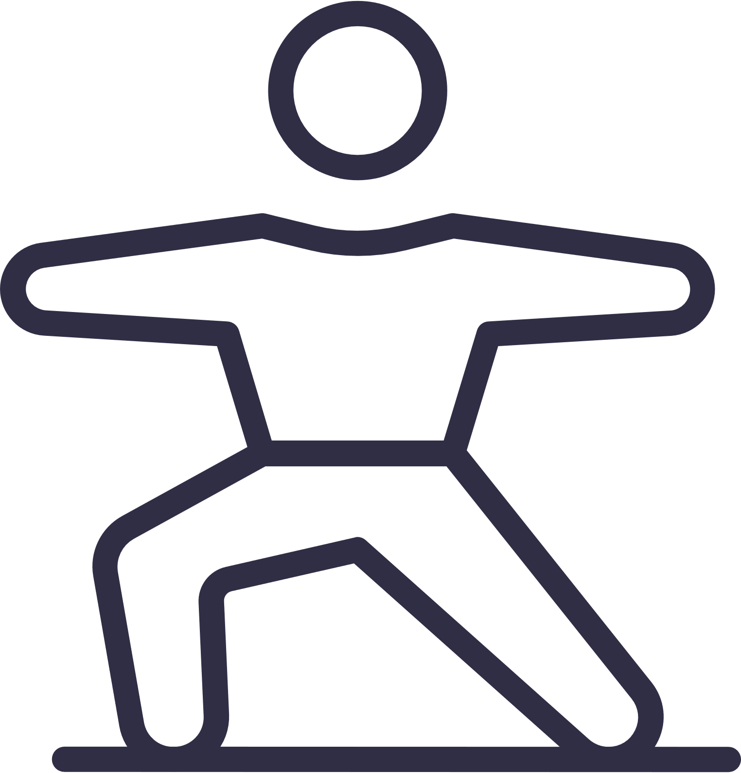
Adopting New Habits (2-20 minutes)
During your day, go out every 1-2 hours, walk around, go outside (if you can), breath, drink coffee/tea
Get 20 min in the sun daily (it will help you sleep better)
Move… short HIIT sessions, Yoga, Pilates (use Reaction app)
Sleep well at night (7-8 hours)
Embrace mindfulness & meditation (2-20 min)
Take a day off…
Me Time (15 min) – listen to music, walk in the park, read a book, take a bath (rule: no phone or airplane mode)
Notes:
So, what small changes can we include in our life?
1.) During your day, go out every 1-2 hours, walk around, stretch, go outside if you can, breathe, drink coffee or tea Explanation: We are a sitting generation, we sit most of the day, in our cars, in the office, when we order grocery and in front of the TV… we must move during the day for our health, concentration and mood. Research shows that going to the gym and working out during the weekend don’t “pay” for the endless sitting during the day, and we must also include the small interventions as part of our day to day.
2) Get 20 min in the sun daily Explanation – it’s important to get real light, not only florescent, for vitamin D production but also to align our body’s natural rhythms – 10-20 minutes in the sun will help you sleep better at night!
3) Sleep well at night – at least 7-8 hours are needed for you to recharge your body and mind!
Explanation: people underestimate the importance of proper sleep – both in length and in quality. This is our body’s maintenance time, and many processes take place during sleep, like removing toxins, memory, cell renewal (beauty sleep 😊) and more… it might be cool to be able to sleep 4-5 hours and manage, but you need to know that Leaders who sleep well, lead well, and it’s important for you both in the short (your health and happiness) and the long term (adding years to your life!)
4) Move… short HIIT (high intensity interval) sessions, Yoga, Pilates… dance, walk in nature – choosing something you like will help you stick to it
5) Embrace mindfulness and meditation for 2-20 minutes, you can choose your way of meditation: listening to music, walking in nature, but make sure to focus on the here and now Explanation: So often we are busy analyzing our past or making scripts, like movie directors, about our future, but at this moment no lion is chasing you, it’s always OK. And giving ourselves the time to feel that it’s OK even for a few minutes is very helpful to reduce our stress levels and incorporate recovery in our life.
6) Take a day off… Explanation: In order to recharge, do things that fill you up. Research shows that a few short vacation days are actually better than one long vacation; I say do both 😊
7) Take some Me Time – a 15-minute daily routine, used for – listening to music, walking in the park, reading a book, taking a bath, but not for being on your mobile device! Explanation: every time you take 5, 10 or 15 minutes to disconnect, do things you like, take care of YOU… you come back more focused, relaxed, and productive. That’s where creativity and innovation come from, and stress levels go down.

Slide 30
Creating a Ritual – Making it stick!
Less is MORE!
It’s OK to fail
Put it in your calendar
Do things after/ before
Believe that change is possible
Create Reminders
Do it together…
Notes:
How do we create those Rituals (Habits) and make small changes in our life?
Less is more also when adopting new habits: choose one habit, maximum 2, our brain is creating new neural connections every time we create a new habit. How long does it take to create a ritual? Some say 21 days, Robin Sharma in his new book - the 5 am club - talks about 50+, I say it is very personal, and again, me-search rather than research and you will learn what works for you. once You establish one habit move to the next one… (we will share a TED talk after the session)
It’s OK to fail – just try and try again
Put it in your calendar, it will really help you find time for it
Sometimes it’s good to decide to connect a new habit to an already established habit – before you brush your teeth, meditate or after your morning coffee, read for 15 minutes, drink a glass of water before every cup of coffee if you want to drink more water.
And research shows that even believing that change is possible can make a difference (we will share a TED talk after the session)
It helps to add good habits to remove bad ones; like taking your phone out of your bedroom if you want to stop reading emails as soon as you wake up or reduce your SM usage
Reminders help – an app, a note on your laptop or fridge, using a bracelet
Do it together – it creates commitment and can be fun!

Slide 31
Breathe
take it all in
Notes:
When we are stressed, our breath is shallow and “stuck” in the upper part of the chest.
Practicing breathing with intention, focusing on the long Inhalation and exhalation and giving ourselves the time to breath even for 2-5-10 minutes is very helpful to reduce our stress levels and incorporate recovery in our life
This can be just sitting still, listening to music, walking – anything that helps us be present in the moment
Mindfulness - without using big words is all about being present in our life. So many times we are busy analyzing our past or making scripts, like movie directors, about our future, but at this moment no lion is chasing you, it’s always OK. Being able to make these short interventions is very important for our well-being.
{ Play some relaxing music, meditation or guide yourself – 2-5 minutes → at the end ask the participants to write down one or two small habits they would like to adopt and commit to. They can share or keep it to themselves…}
You can check out my Spotify for relaxing music (you need to share computer audio in Zoom advanced options to play) https://open.spotify.com/playlist/4flPkI23AO5S95ApLTZXgb?si=3Pxqo3DFT2yrAnv5pQ_mHA

Slide 32
How can we create a culture of well-being?

Slide 33
In Simple Words…
Health, Happiness, Productivity, Focus, Creativity & Innovation,
Employees Well-being
A proactive approach to well-being
Impacting the company’s bottom line!
​Integrating well-being into the design of work itself can strengthen the link between worker well-being and organizational performance, supporting well-being not just for individuals but for teams and for the organization at large.
Deloitte May 2020
Notes:
Well-being as a proactive approach to increase happiness and improve health rather than a preventative tool that addresses pain & sickness
It is well known that employees’ well-being contributes not only to Health, Happiness, Productivity, Focus, Creativity & Innovation, it actually impacts the company’s bottom line
Latest paper by Deloitte (see quote on slide)

Slide 34
Creating Well-being on My Team
Notes:
Trio - share tips on creating well-being in my team - conclude on the whiteboard
Examples of how small changes in your well-being directly impact your employees’ well-being, and what can be done on your teams to promote a culture of well-being
Your Well-being
Impacts your employees’ well-being!
Embed recovery during your day (2-20 minute interventions)
You can’t give to others what you don’t have yourself…
→Happy leaders: Make better decisions • Prioritize scarce resources better • Manage their time better • Have more empathy for others • Are more optimistic • Make their employees happier • Achieve more business success
Create boundaries between work and no work (family, hobby, sports, play, nature, meditation) time & space
When you work – work, when you rest – rest… →This has been proven to reduce burnout, boost creativity, innovation & productivity
Take care of your physical well-being – movement, nutrition, sleep
→ A manager’s leadership behavior affects employees’ emotions throughout the workday
Leaders who sleep well, lead well
Short movement interventions like stretching or walking down the corridor improve concentration, enhance creativity, lower stress & improve mood
Practice mindfulness & mediation Choose your ME Time style
→Embed mindfulness & mediation in meetings, practice mindful listening
Invest in your Mental well-being –
Appreciating the good things we have makes us happy
→Point out and celebrate the good things at the workplace
Show, write thank you notes, praise someone in meetings in front of co-workers
Invest in relationships – family, friends, colleagues – Surround yourself with people who care about you
→Leaders who have good relationships with their employees are happier and less stressed
Encourage employees to connect with peers
Make sure your employees are seen and that you know how they (really) feel
Doing good - We get most happiness from helping others
→ Help employees do things for others – their peers and the ecosystem, volunteer together as a team

Slide 35
Summary
Notes:
How can you identify burnout?
Burnout doesn’t hit all at once,
be attentive to the following signs:
Exhaustion. Feeling physically and emotionally depleted. Physical symptoms may include headaches, stomachaches, and changes in appetite or sleep habits.
Isolation. People with burnout tend to feel overwhelmed. As a result, they may stop socializing and confiding in friends, family members, and co-workers. They can be over cynical, edgy, they can ask you for the ‘bottom line’ as they cannot deal with details. This can be with co-workers, employees but also with their kids…
Escape fantasies. They become dissatisfied with the never-ending demands of their jobs, people with burnout may fantasize about running away or going on a solo-vacation. In extreme cases, they may turn to drugs, alcohol, or food as a way to numb their emotional pain.
Irritability. Burnout can cause people to lose their cool with friends, co-workers, and family members more easily. Coping with normal stressors like preparing for a work meeting, driving kids to school, and tending to household tasks may also start to feel insurmountable, especially when things don’t go as planned.
Frequent illnesses. Burnout, like other long-term stress, can lower your immune system, making you more susceptible to colds, the flu, and insomnia. Burnout can also lead to mental health concerns like depression and anxiety.
Those employees who invest most in their work are often those who face burnout. And we need to watch out for the signs. First look at yourself in the mirror and then talk to our employees and be alert for signs of burnout.

