Slide 1
Managing by Objectives.
Driven by Outcomes.
Notes:
1

Slide 2
Why?
The unique era we now operate in puts great responsibility on managers to manage remote teams in time of change.
The overload, work & personal boundaries become more and more complex and create a feeling of exhaustion.
Lack of focus and priorities affect employees’ ability to perform at their best and meet expectations
Setting goals and managing by outcomes will empower your employees to be accountable for their commitments, any where, any time, any way

Slide 3
The Rationale?
Setting objectives drives outcomes, encourages accountability & demonstrates success through metric indicators.
Objectives should be challenging, yet realistic & doable within a given timeframe.
Aligning conversations is especially important for cross-functional team goals.

Slide 4
What helps me define the team objectives
Vertical
Horizontal
Alignment with your
manager and with corporate strategy
Alignment with your
peers and stakeholders
Do my objectives support my function and/or business unit?
Are my objectives linked to other, higher-level goals and objectives?
Can linkages be clearly communicated to other individuals, teams and organizations so the goals are easy for others to align with?
Have I shared my objectives with my peers and stakeholders?
Have I calibrated the level of difficulty of my direct report’s objectives with those of their peers?
Have I checked for potential conflict or overlap of objectives?
What dependencies are there?
Do my timelines depend on others? Are they aware of their responsibilities?
What resources do I need from others?
Do the objectives reflect needs/expectations of customers and stakeholders?
Does my success rely on other people?
Have I sought input from those who may be affected by my objectives?

Slide 5
Re-prioritize the team focus
Empower your team and encourage creativity for process improvement: Consult with them on planning and timelines, potential obstacles, risks and mitigations to get assignments completed on time.
Invite people to share different PoVs on what can improve work and save time for the whole team, encourage them to brainstorm and come up with innovative ideas. You can use the Pareto Principle (AKA 20/80 rule).
This principle implies that 80% of our output comes from 20% of our efforts. It can help you explore where you need to devote efforts so as to increase productivity and performance.
Explore where your 20% lies - and become more productive, or explore where your 80% lies, and improve these cases.

Slide 6
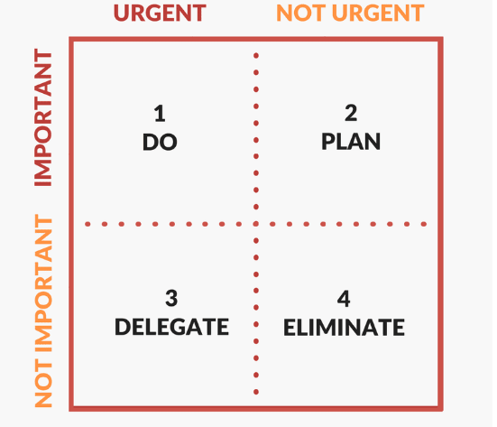
Team / Individual Focus
Rescope and re-prioritize tasks based on the unit’s objectives
Whenever possible, reevaluate initiatives that are not urgent or meet immediate needs
Aligned
Your focus
Postpone or Pareto/ Identify bottle necks
Not Aligned
Push for new owners
Remove

Slide 7
What Do Successful Objectives Look Like?
Frequently discussed
Objectives should be embedded in ongoing discussions to review progress, prioritize initiatives, and provide feedback
Ambitious
Objectives should be challenging yet possible to achieve
Specific
Should be translated into concrete metrics and milestones that force clarity on how to achieve each expectation and measure progress
Transparent
Objectives and current performance should be made public for employees to see

Slide 8
How To Set Clear 0bjectives
Ask yourself
Keep in mind
Setting Objectives
What are the objectives for the coming quarter?
F.A.S.T & Effective
What will success look like? Are the expectations challenging (yet attainable)? What value do they provide?
Key results
How will you measure the key deliverables expected from the employee?
Excellence Standards
How can the excellence standards assist in successfully achieving the goals?
Development focus
Focusing on the employee, what can be areas of development/ improvement?
Focus on major 3-5 objectives. Quarterly basis. Document in the system

Slide 9
Suggested 1:1 outline discussion
Step | Points for discussion
Why | The coronavirus has created a new situation for all of us, both in our personal life and also here at work. High employee engagement will allow more productivity, which will ultimately make us more successful. The purpose of setting objectives and managing by outcomes is to empower your employees to be accountable for their commitments, any where, any time, any way.
What | Alignment. Focus. Outcomes Define 3 -5 focuses each quarter and the desired outcomes. Setting a limited number of focuses/ goals directs your team/ employee to be focused & produce better results.
How | Establish a safe atmosphere where people feel comfortable sharing their aspirations and input. Share the group objective for the upcoming quarter Share the action plans in order to fulfil the objectives Foster an open discussion using the following questions: Based on the unit objectives - How would you define your personal objectives for which you will be responsible in the next quarter? What activities are you passionate about that will best demonstrate your strengths? What challenges might you experience delivering upon those objectives? What is the action plan that will help you achieve these objectives? (Keeping you energized and motivated) Ask - Can you commit to all of this? What support or resources do you need in order to meet the quarterly objectives?
Follow-up and communication | 1:1s are a perfect medium of communication for both parties. Employees can share their input and managers have a clear perspective on how the employees are doing. Define with your employee a follow up mechanism to help your employee meet their objectives, develop an action plan with them to help them improve for the next project.
Closure | Thank your employee and invite him/her to share any need, personal or work related Be committed to following up with your employees

Slide 10
The Power of Following Up with Your Employees
As a best practice, share with your employee in advance what the content of the discussion will be. By knowing the purpose of the meeting, employees feel less threatened & more engaged.
Discuss their achievements, what they have learned, & what their next objectives are. Use 1:1 sessions to help employees meet their objectives. Develop action plans with them to enable continuous improvement.
Employees get an opportunity to share their achievements, frustrations, & career plans with their managers. Knowing that your manager cares about your experience within the company & understanding expectations, increase employee engagement & motivation in the workplace.

