Slide 1
Manage Employees’ Motivations
Leverage Strengths
and Passions

Slide 2
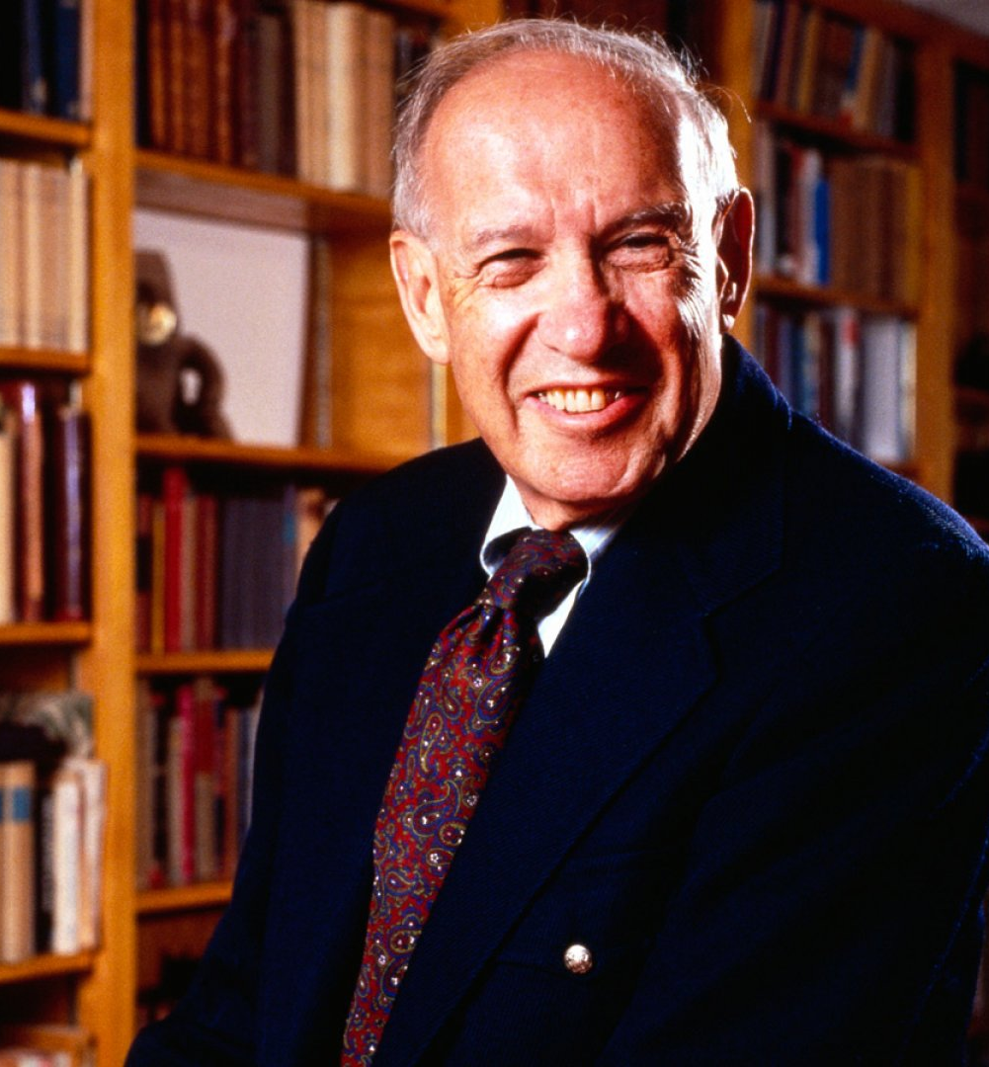
“Only when you operate from strengths can you achieve true excellence... One cannot build performance on weaknesses.”
It takes far more energy to improve from incompetence to mediocrity than to improve from first-rate performance to excellence.”
Peter Drucker “the man who invented management”

Slide 3
Research supports: Success lies in strengths
Managers who do what they do best every day are 38% more likely to be in a high-productivity BU
Employees who say they use their strengths every day are 8% more productive and 15% less likely to quit their jobs
Yet only 20% of employees and only 9% of managers feel they do what they do best every day
The most successful managers leverage strengths and passions 6 times more often
Teams that received strengths-based development:

Slide 4
The sweet spot
What am I passionate about?
What are the needs and goals of the organization?
What am I born to do?
What are the needs of my family, relatives and my personal needs?
Our role as managers is to find the sweet spot common to all circles

Slide 5
How to identify my strengths
VIA Strengths Profile
Think of your best self
Think of a specific time when you were at your best – you were thriving & flourishing. What were you doing at that time? What contributed to this positive experience.
Assessment
Ask close connections
When you’ve seen me at my best, which top two qualities were most dominant?
Reflection
Inquiry

Slide 6
This is what your report will look like
Basic framework

Slide 7
Leveraging your employee’s strengths & motivations
When you look at your people’s day-to-day activities, what are they doing when you see sparks in their eyes?
For which tasks do you see the level of energy going up with excellent results?
When are they more involved, asking more questions, getting deliverables done faster, being proactive? You see them smiling… They have a good vibe…
If you asked them, what would they say motivates them? What would they like to do more of?

Slide 8
Thank You

